Slide 1
Data Analytics Capstone – Final Presentation
Understanding Career Aspirations of Gen Z
Made by - Shravani raut

Slide 2
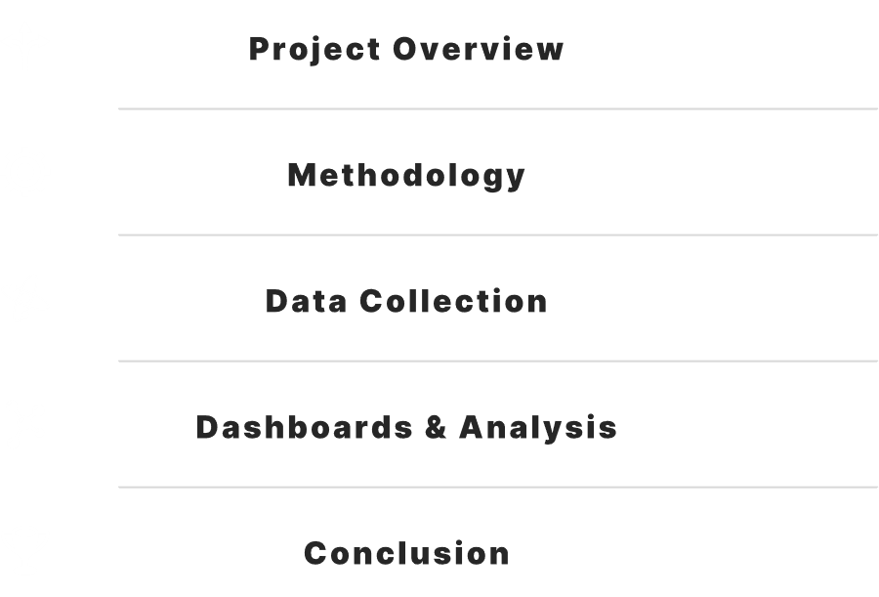
Content

Slide 3
01 project overview

Slide 4
Project overview
The project focuses on understanding the career aspirations, learning preferences, leadership expectations, and job satisfaction indicators of Gen Z professionals.
It uses data-driven methods to deliver insights that help employers align with Gen Z expectations.

Slide 5
02 methodology

Slide 6
methodology
1. Created Excel dashboards for service, finance, and orders
2. Defined business problem using “Who? What? When? Why? Where?”
3. Collected data through Google Form
4. Cleaned and analyzed the data using SQL
5. Visualized findings through Power BI dashboards

Slide 7
03 data collection

Slide 8
Data collection
Survey conducted using Google Form targeting Gen Z participants
Data imported into MySQL Workbench
Cleaned and transformed using SQL queries
Ensured consistency and removed missing/null values

Slide 9
04 dashboard and analysis

Slide 10
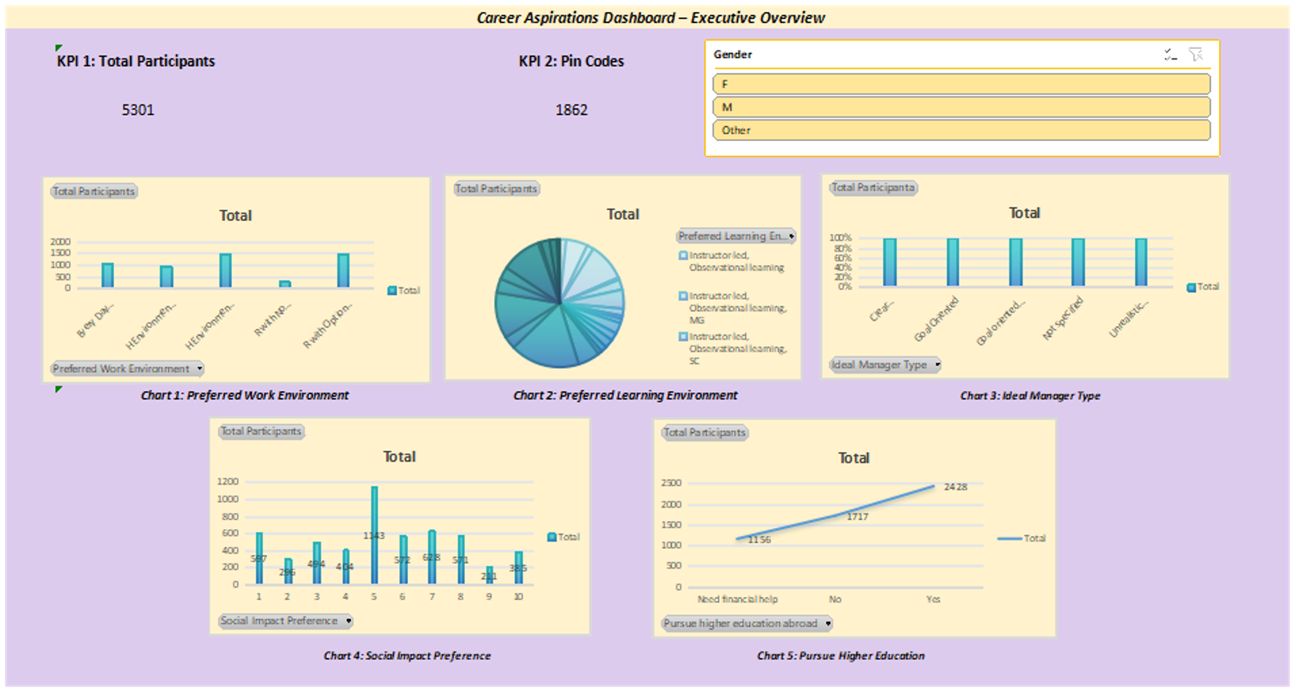

Slide 11
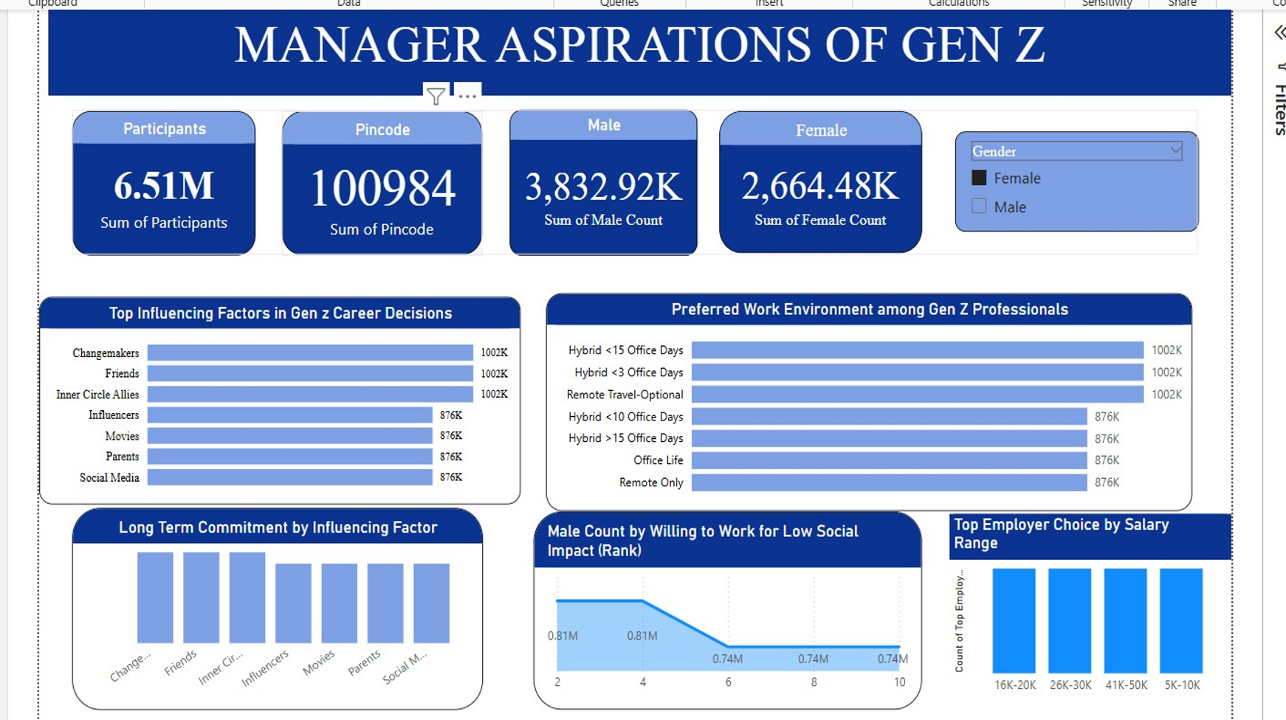

Slide 12
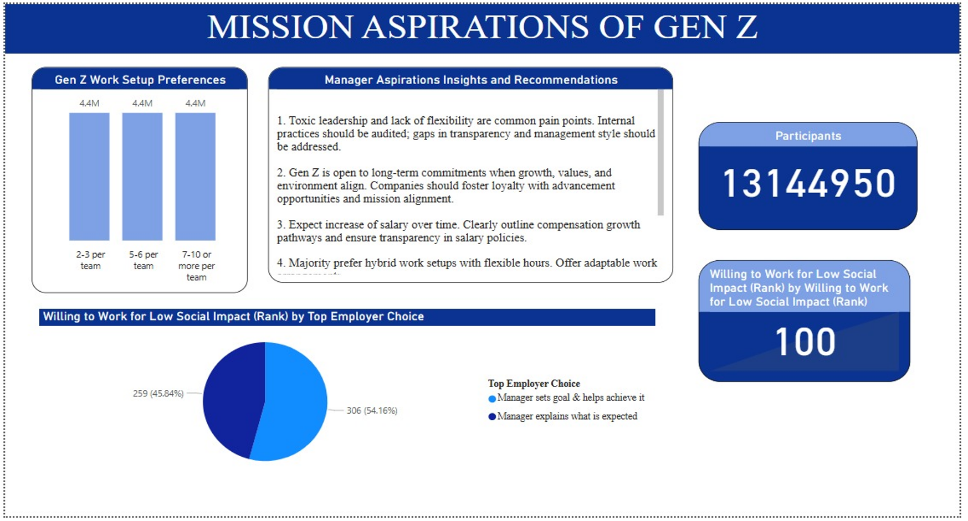

Slide 13
Key insights
🔹 Gen Z prioritizes personal growth — Opportunities to learn and advance matter more than initial salary.
🔹 Leadership quality is crucial — Survey responses highlighted dissatisfaction with poor leadership and lack of feedback.
🔹 Recognition and appreciation — Regular acknowledgment was ranked higher than bonuses or perks.
🔹 Workplace culture matters — Gen Z values inclusive, mission-driven environments aligned with their personal values.
🔹 Platform reputation influences decisions — Sites like Glassdoor and Comparably play a major role in job consideration.

Slide 14
Technologies used
Google Forms – Data collection from Gen Z respondents
Microsoft Excel – Data preprocessing and dashboarding
MySQL Workbench – Data cleaning and SQL-based analysis
Power BI – Interactive dashboard creation and data visualization
Canva / PowerPoint – Report design and presentation
Google Sheets – Initial data review and filtering
Power Query Editor – Data transformation inside Power BI

Slide 15
05 project summarisation

Slide 16
Project summarisation
This project analyzed the career aspirations of Gen Z through survey data collected via Google Forms.
The data was cleaned using MySQL and visualized using Power BI dashboards.
Key insights revealed Gen Z values growth opportunities, leadership quality, and recognition over salary.
Actionable recommendations were proposed to help organizations better engage and retain Gen Z talent.

Slide 17
06 organisation and structure

Slide 18
organisation and structure
This project, conducted under the organization KultureHire, focused on analyzing the career aspirations of Gen Z using a structured data analytics approach.
The project followed a clear structure:
Data Collection – via Google Forms targeting Gen Z professionals
Data Cleaning & Analysis – using MySQL for preprocessing and insights
Visualization – using Power BI to create interactive dashboards
Findings & Recommendations – based on key patterns and survey responses
The results showed that Gen Z prioritizes growth, leadership quality, and recognition over compensation.
Actionable strategies were proposed to help organizations align with these expectations and improve workforce engagement.

Slide 19
thankyou

